Slide 1
Presentation to Management
Ray Chandonnet
DSE5002
R Final Project

Slide 2
Executive Summary – Key Assumptions and Recommendations
Basic Recommendations / Assumptions
Given management’s desire to hire an impactful individual who will grow the time, we recommend hiring someone with senior-level or executive-level experience
Based on our research, we feel management will need to decide whether to prioritize:
Data engineering – the underlying architecture of our data
Set up and maintain the systems that acquire, cleanse, normalize and store the data in forms that can be used to perform analytics and machine learning
Strong on data fundamentals, weaker on analytics
Data science – Insights developed using our data (strong on analytics, weaker on data architecture
Find meaning in the data that the engineers manage through advanced analytics and Artificial Intelligence
Both – More senior leader experienced building out and overseeing both functions
We recommend deferring hiring anyone with Artificial Intelligence / Machine Learning capabilities until we first put our data processes in place
Salary Expectations
Salaries across the spectrum of skillsets are materially higher in the US than offshore
However, offshore salaries have rise dramatically over the last few years whereas salaries in the US are stagnant to dropping as demand shifts overseas
Salaries for data engineers, and individuals who can build out both engineering and analytics, are materially higher than salaries for data scientists
Paying offshore salaries to employees in their native currency can reap significant cost benefits but can be quite volatile due to exchange rates

Slide 3
Salary Recommendations – By Specialization, Seniority and Location
Specialization | Seniority | Salary (US-Based) | Salary (Offshore)
Data Scientist | Senior | 135,000 | 100,000
Data Science | Executive | 145,000 | 115,000
Engineering | Senior | 162,500 | 115,000
Engineering or Head of Data | Executive | 215,000 | 125,000
Head of Data | Senior | 200,000 | 185,000
Engineering or Head of Data | Executive | 225,000 | 200,000
As mentioned previously, management will need to determine which areas are most important for the first hire, how senior an individual to hire, and whether to hire domestically or offshore
These salary recommendations are roughly based on average salary data for the respective categories for the last 2 years, adjusted to reflect growth trends domestically and offshore
Supporting data can be found in the appendices following this summary

Slide 4
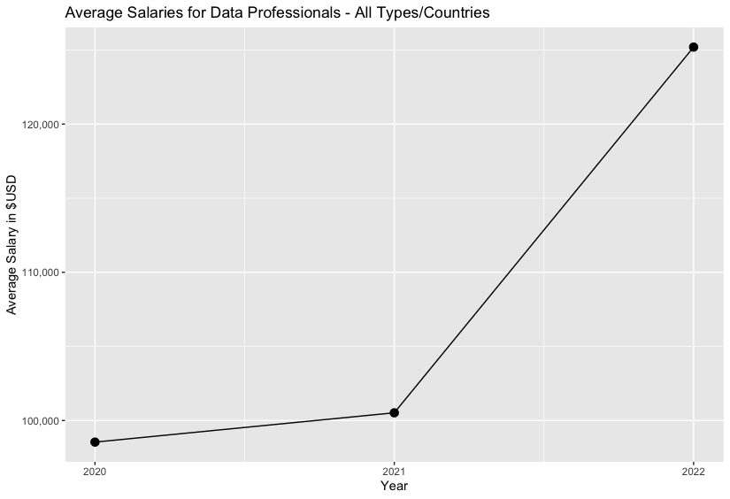
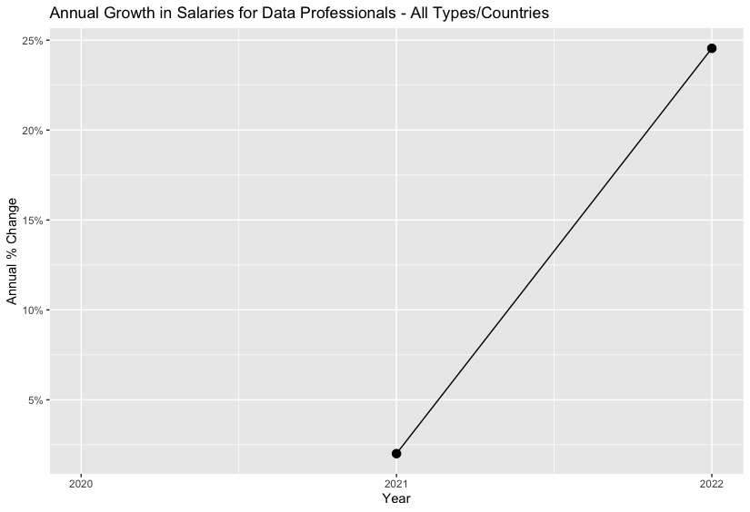
Appendix 1: Overall Growth in Salaries for Data Scientists
After modest growth in 2021, average salaries for data scientists (across all roles / regions) grew significantly in 2022:
USD$ average salary rose from ~$100k to $125
This represented approximately 25% per growth
However, was this growth even across all roles / regions?

Slide 5
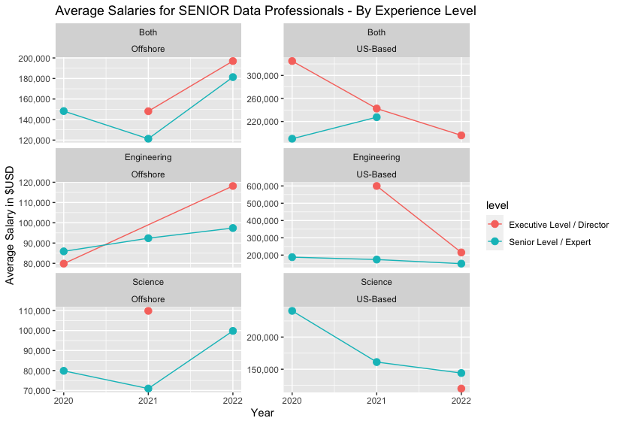
Appendix 2: Current and Historical Salaries by specialization, seniority and region
Salary growth occurred almost entirely offshore, whereas salaries appear to have declined in the US though missing and anomalous data makes this less than certain
Substantive data for 2022 is available on which to form expectations for salary requirements going forward, adjusted for overall trends

Slide 6
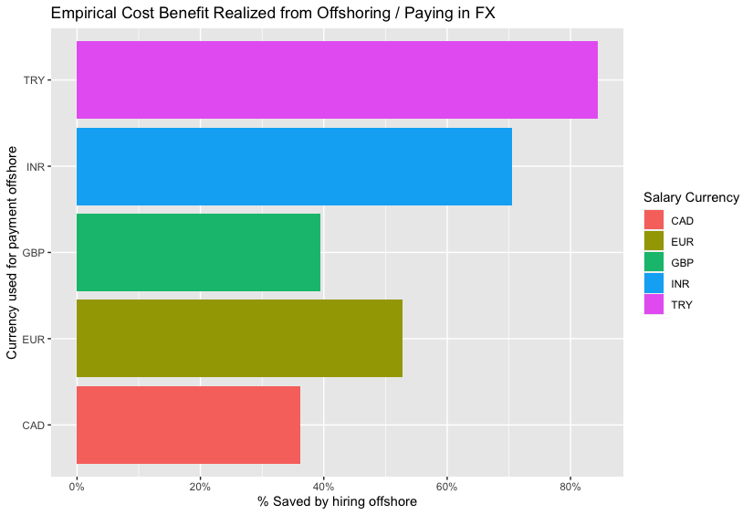
Appendix 3: Benefit of paying offshore employees in foreign currency
Associated Countries
TRY = Turkey
INR = India
GBP = England
EUR = Eurozone
CAD = Canada
If we compare salaries, paid for comparable job titles, seniority and time periods in the US vs. offshore, paid in FX and converted to USD, we find very significant benefits from offshoring and paying native currency.
This assumes foreign exchange rates stay stable though, or there is a mechanism by which we can hedge the FX risk of paying offshore employees in other than USD

Slide 7
Appendix 4: Salary data summarixzation used to make salary recommendations
Year | Specialty | Domicile | Avg Salary | Seniority
2021 | Engineering | US-Based | 600,000 | Executive Level / Director
2021 | Engineering | Offshore | 92,398 | Senior Level / Expert
2021 | Engineering | US-Based | 174,364 | Senior Level / Expert
2021 | Head of Data | Offshore | 148,108 | Executive Level / Director
2021 | Head of Data | US-Based | 242,500 | Executive Level / Director
2021 | Head of Data | Offshore | 121,293 | Senior Level / Expert
2021 | Head of Data | US-Based | 227,500 | Senior Level / Expert
2021 | Science | Offshore | 109,871 | Executive Level / Director
2021 | Science | Offshore | 70,951 | Senior Level / Expert
2021 | Science | US-Based | 161,154 | Senior Level / Expert
2022 | Engineering | Offshore | 118,187 | Executive Level / Director
2022 | Engineering | US-Based | 215,333 | Executive Level / Director
2022 | Engineering | Offshore | 97,413 | Senior Level / Expert
2022 | Engineering | US-Based | 150,505 | Senior Level / Expert
2022 | Head of Data | Offshore | 196,979 | Executive Level / Director
2022 | Head of Data | US-Based | 195,938 | Executive Level / Director
2022 | Head of Data | Offshore | 181,337 | Senior Level / Expert
2022 | Science | US-Based | 120,000 | Executive Level / Director
2022 | Science | Offshore | 99,815 | Senior Level / Expert
This summary table shows average salary paid in 2021 /2022 for full-time senior and executive level data scientists and engineers, excluding Artificial Intelligence / Machine Learning specialists
It is segregated by region, and was used as the objective basis for the salary recommendations provided in the executive summary

